Slide 1


Chapter 4.
Navigation and Routing
Giảng viên: Từ Thị Xuân Hiền
Notes:
NOTE:
To change the image on this slide, select the picture and delete it. Then click the Pictures icon in the placeholder to insert your own image.

Slide 2
What is Navigation in React?
Navigation means browsing between various parts of the application. In React mostly SPA (Single Page Application) are developed so Navigation is complex.
We do not load new pages from the server side each time a navigation link is pressed instead routing is implemented on the client side.
To implement routing in React we use the react-router-dom module after installing and importing it.

Slide 3
Navigation and Routing
Navigation and Routing refer to the process of determining which component to render based on the current URL or user interaction.
In a multi-page application, this typically involves loading entirely new HTML pages from the server
in a single-page application (SPA) like those built with React, routing and navigation are handled on the client side without full page reloads

Slide 4
Routing and navigation
React provides a library called React Router that simplifies the process of adding routing and navigation to your applications.
React Router allows you to define routes and components associated with those routes, making it easy to display the appropriate content based on the current URL.

Slide 5
Why Use Routing and Navigation?
Enhanced User Experience: SPAs provide a smoother and faster user experience by loading only the necessary content when navigating between pages, reducing the need for full page refreshes.
Better Organization: Routing allows you to organize your application into multiple views or pages, making the codebase more manageable and maintainable.

Slide 6
Why Use Routing and Navigation?
Bookmarkable URLs: SPAs can still have bookmarkable URLs, allowing users to share or save specific application states.
Search Engine Optimization (SEO): Properly configured SPAs with server-side rendering can be SEO-friendly, improving search engine visibility

Slide 7
What is React Router?
React Router is a standard library for creating dynamic routes and navigation in React JS Applications. It allows you to manage navigation in your app by defining routes that connect the URL paths to specific components.
With React Router, you can implement different views for different parts of your application without the need for a full-page refresh. This is a key feature of single-page applications (SPAs), where only the necessary content is updated as the user navigates.

Slide 8
Features of React Router
Declarative Routing: React Router v6 uses the Routes and Route components to define routes declaratively, making the routing configuration simple and easy to read.
Nested Routes: It supports nested routes, allowing for complex and hierarchical routing structures, which helps in organizing the application better.
Programmatic Navigation: The useNavigate hook enables programmatic navigation, allowing developers to navigate between routes based on certain conditions or user actions.

Slide 9
Features of React Router
Route Parameters: It provides dynamic routing with route parameters, enabling the creation of routes that can match multiple URL patterns.
Improved TypeScript Support: Enhanced TypeScript support ensures that developers can build type-safe applications, improving development efficiency and reducing errors.

Slide 10
Understanding React Router’s router
A router in React Router is a component that tracks the browser’s URL and performs navigation.
Several routers are available in React Router, and the one recommended for web applications is called a browser router.
The createBrowserRouter function creates a browser router.
createBrowserRouter function requires an argument containing all the routes in the application.

Slide 11
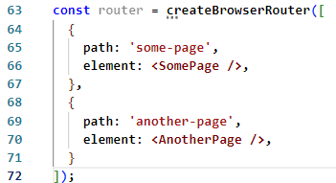
Understanding React Router’s router
The following code snippet creates a router with two routes:
Notes:
import React from 'react'
import {createBrowserRouter, RouterProvider } from 'react-router-dom'
import './App.css'
function Home() {
return (
<div>
<h1>My Home Page</h1>
</div>
)
}
function Product() {
return (
<div>
<h1>Product Page!</h1>
</div>
)
}
const router = createBrowserRouter(
[
{path: '/', element: <Home />},
{path: '/product', element: <Product />},
]
)
const App = () => {
return <RouterProvider router={router} />
};
export default App

Slide 12
Components of React Router
BrowserRouter and HashRouter
BrowserRouter: Uses the HTML5 history API to keep your UI in sync with the URL.
HashRouter: Uses the hash portion of the URL (i.e., window.location.hash) to keep your UI in sync with the URL.
<BrowserRouter>
(/* Your routes go here */}
</BrowserRouter>

Slide 13
Components of React Router
Routes and Route
Routes: A container for all your route definitions.
Route: Defines a single route with a path and the component to render.
<Routes>
<Route path="/" element={<Home />} />
<Route path="/about" element={<About />} />
</Routes>
Notes:
import React from 'react'
import {createBrowserRouter, createRoutesFromElements, RouterProvider, Route } from 'react-router-dom'
import './App.css'
function Home() {
return (
<div>
<h1>My Home Page</h1>
</div>
)
}
function Product() {
return (
<div>
<h1>Product Page!</h1>
</div>
)
}
const routerDefinitions = createRoutesFromElements(
<Route>
<Route path="/" element={<Home />} />
<Route path="/product" element={<Product />} />
</Route>
);
const router = createBrowserRouter(routerDefinitions);
const App = () => {
return <RouterProvider router={router} />
};
export default App

Slide 14
Components of React Router
Link and NavLink
Link: Creates navigational links in your application.
NavLink: Similar to Link but provides additional styling attributes when the link is active.
<nav>
<NavLink to="/" activeClassName="active">Home</NavLink>
<Link to="/about">About</Link>
</nav>
Notes:
import React from 'react'
import {createBrowserRouter, RouterProvider, Link } from 'react-router-dom'
import './App.css'
function Home() {
return (
<div>
<h1>My Home Page</h1>
<p> Go to <Link to="/product">The list of Product</Link></p>
</div>
)
}
function Product() {
return (
<div>
<h1>Product Page!</h1>
</div>
)
}
const router = createBrowserRouter(
[
{path: '/', element: <Home />},
{path: '/product', element: <Product />},
]
)
const App = () => {
return <RouterProvider router={router} />
};
export default App

Slide 15
Steps to Create Routes using React Router
Step 1: Initialize React Project
Create React application using the following command.
Step 2: Install React Router
Install react-router in your application write the following command in your terminal
npx npm create vite@latest react-router-example
cd react-router-example
npm install react-router-dom@6

Slide 16
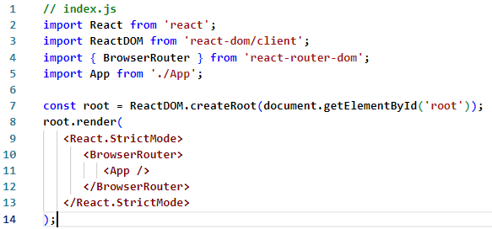
Steps to Create Routes using React Router
Step 3: set up and configure the React router for project.
Navigate to the index.js file, which is the root file, and import BrowserRouter from the react-router-dom package that we installed, wrapping it around our App component as follows:

Slide 17
Steps to Create Routes using React Router
Step 4: Configure routes in React
Use React router to implement routing. The first step is configuring all of our routes (all the pages/components we want to navigate).
Create those components: the Home page, the About Page, and the Products Page. This GitHub repository contains the content for these pages.

Slide 18
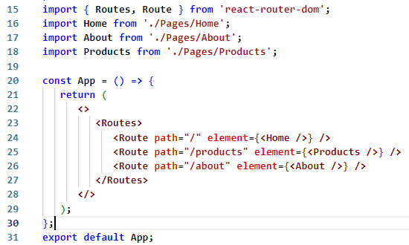
Steps to Create Routes using React Router
Step 4: Configure routes in React
Notes:
import React from 'react'
import {BrowserRouter, RouterProvider, Link, Routes, Route } from 'react-router-dom'
import './App.css'
function Home() {
return (
<div>
<h1>My Home Page</h1>
<p> Go to <Link to="/product">The list of Product</Link></p>
</div>
)
}
function Product() {
return (
<div>
<h1>Product Page!</h1>
</div>
)
}
const App = () => {
return (
<>
<Routes>
<Route path="/" element={<Home />} />
<Route path="/product" element={<Product />} />
</Routes>
</>
)
};
export default App

Slide 19
Steps to Create Routes using React Router
The above code, we imported Routes and Route components from react-router-dom and then used them to declare the routes we want.
All Routes are wrapped in the Routes tag, and these Routes have two major properties:
path: identifies the path we want users to take to reach the set component. When we set the path to /about, for example, when the user adds /about to the URL link, it navigates to that page.
element: This contains the component that we want the set path to load.

Slide 20
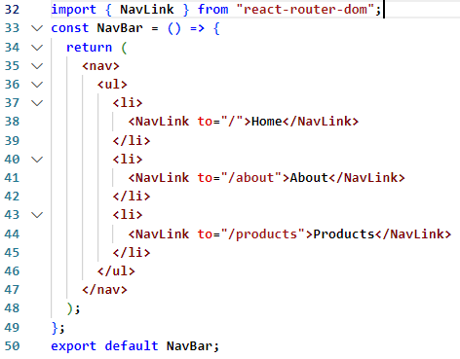
Steps to Create Routes using React Router
Step 5: Adding a navigation bar
The NavLink component from react-router-dom is a special component that helps you navigate different routes using the to prop.
The NavLink component also knows whether the route is currently "active" and adds a default active class to the link.

Slide 21
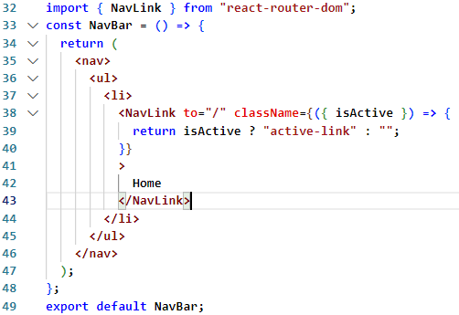
Steps to Create Routes using React Router
The NavLink component gives us access to properties like isActive

Slide 22
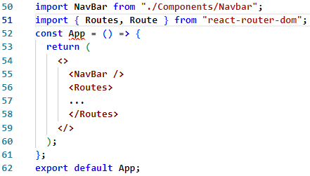
Steps to Create Routes using React Router
Finally, let us use the Navbar component inside our App.
Notes:
How to fix No Routes Found Error
When routing, a situation may cause a user to access an unconfigured route or a route that does not exist; when this occurs, React does not display anything on the screen except a warning with the message "No routes matched location."
This can be fixed by configuring a new route to return a specific component when a user navigates to an unconfigured route as follows:
// App.js
import { Routes, Route } from 'react-router-dom';
import NoMatch from './Components/NoMatch';
const App = () => {
return (
<>
<Routes>
// ...
<Route path="*" element={<NoMatch />} />
</Routes>
</>
);
};
export default App;
In the preceding code, we created a route with the path * to get all non-configured paths and assign them to the attached component.

Slide 23
Steps to Create Routes using React Router
Finally, let us use the Navbar component inside our App.
Notes:
import React from 'react'
import {createBrowserRouter, RouterProvider, Link, Outlet} from 'react-router-dom'
import './App.css'
function ErrorPage(){
return (
<div>
<MainNavigation />
<h1>404 Page Not Found!</h1>
</div>
)
}
function MainNavigation(){
return (
<header>
<nav>
<ul>
<li>
<Link to="/">Home</Link>
</li>
<li>
<Link to="/product">Product</Link>
</li>
</ul>
</nav>
</header>
)
}
function Home() {
return (
<div>
<h1>My Home Page</h1>
</div>
)
}
function Product() {
return (
<div>
<h1>Product Page!</h1>
</div>
)
}
function RootLayout(){
console.log('====================================');
console.log('Root Layout!');
console.log('====================================');
return (
<div>
<p>Root Layout!</p>
<MainNavigation />
<Outlet />
</div>
)
}
const router = createBrowserRouter(
[
{path: '/',
element: <RootLayout />,
errorElement: <ErrorPage />,
children: [
{path: '/', element: <Home />},
{path: '/product', element: <Product />}]
},
]
)
const App = () => {
return <RouterProvider router={router} />
};
export default App

Slide 24
Creating navigation
React Router comes with components called Link and NavLink, which provide navigation.
Using the Link component
The Link component is the basic building block for creating navigation links in React application. It renders an anchor tag (<a>) in the DOM and allows you to navigate between components without a full page reload
Notes:
import React from 'react'
import {createBrowserRouter, RouterProvider, Link, Outlet} from 'react-router-dom'
import './App.css'
function MainNavigation(){
return (
<header>
<nav>
<ul>
<li>
<Link to="/">Home</Link>
</li>
<li>
<Link to="/product">Product</Link>
</li>
</ul>
</nav>
</header>
)
}
function Home() {
return (
<div>
<h1>My Home Page</h1>
</div>
)
}
function Product() {
return (
<div>
<h1>Product Page!</h1>
</div>
)
}
function RootLayout(){
console.log('====================================');
console.log('Root Layout!');
console.log('====================================');
return (
<div>
<p>Root Layout!</p>
<MainNavigation />
<Outlet />
</div>
)
}
const router = createBrowserRouter(
[
{path: '/', element: <RootLayout />,
children: [
{path: '/', element: <Home />},
{path: '/product', element: <Product />}]
},
]
)
const App = () => {
return <RouterProvider router={router} />
};
export default App

Slide 25
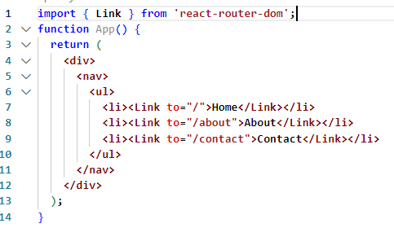
Creating navigation
Using the Link component

Slide 26
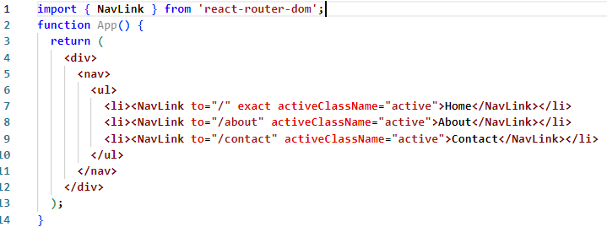
Creating navigation
Using the NavLink Component
NavLink is a special version of Link that can style itself as "active" when it matches the current URL. This is particularly useful for highlighting the current page in a navigation menu.
Notes:
import React from "react";
import "./App.css";
import { BrowserRouter as Router, Routes, Route, NavLink } from "react-router-dom";
const Home = () => <h2>Trang Chủ</h2>;
const About = () => <h2>Giới Thiệu</h2>;
const Contact = () => <h2>Liên Hệ</h2>;
const Navbar = () => {
return (
<nav>
<NavLink
to="/"
className={({ isActive }) => (isActive ? "active-link" : "")}
>
Trang Chủ
</NavLink>
{" | "}
<NavLink
to="/about"
className={({ isActive }) => (isActive ? "active-link" : "")}
>
Giới Thiệu
</NavLink>
{" | "}
<NavLink
to="/contact"
className={({ isActive }) => (isActive ? "active-link" : "")}
>
Liên Hệ
</NavLink>
</nav>
);
};
const App = () => {
return (
<Router>
<Navbar />
<Routes>
<Route path="/" element={<Home />} />
<Route path="/about" element={<About />} />
<Route path="/contact" element={<Contact />} />
</Routes>
</Router>
);
};
export default App;
//.active-link {
// font-weight: bold;
// color: red;
//}

Slide 27
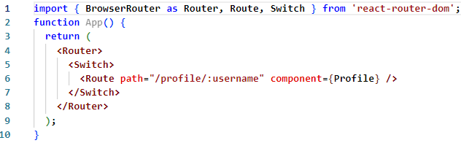
URL Parameters in React Router
URL parameters are a fundamental aspect of web development, allowing us to create dynamic routes that respond to different data inputs
To define a route with parameters in React Router, use a colon: followed by the parameter name in the path prop of the Route component.
Examp:
Notes:
import React from "react";
import { BrowserRouter as Router, Routes, Route, NavLink, useParams } from "react-router-dom";
const Home = () => <h2>Trang Chủ</h2>;
const UserProfile = () => {
const { username } = useParams(); // Lấy tham số từ URL
return <h2>Xin chào, {username}!</h2>;
};
const Navbar = () => {
return (
<nav>
<NavLink to="/" className={({ isActive }) => (isActive ? "active-link" : "")}>
Trang Chủ
</NavLink>
{" | "}
<NavLink to="/user/johndoe" className={({ isActive }) => (isActive ? "active-link" : "")}>
Hồ sơ John
</NavLink>
{" | "}
<NavLink to="/user/alice" className={({ isActive }) => (isActive ? "active-link" : "")}>
Hồ sơ Alice
</NavLink>
</nav>
);
};
const App = () => {
return (
<Router>
<Navbar />
<Routes>
<Route path="/" element={<Home />} />
<Route path="/user/:username" element={<UserProfile />} />
</Routes>
</Router>
);
};
export default App;

Slide 28

URL Parameters in React Router
Accessing URL Parameters: use the useParams hook provided by React Router. This hook returns an object with key-value pairs:
The key is the name of the URL parameter
The value is the actual value from the URL
Examp:
When you navigate to /profile/johndoe, the Profile component will render "Welcome to johndoe's profile!".

Slide 29
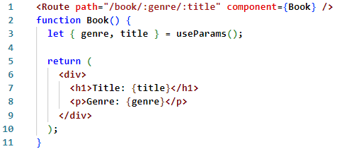
URL Parameters in React Router
Working with Multiple Parameters: We can also define multiple parameters in a single route:
Examp:

Slide 30
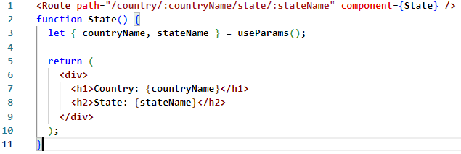
URL Parameters in React Router
Nested Routes and Parameters: When working with nested routes, each level of routing can have its own parameters.
In the State component, you would access both countryName and stateName parameters:
Notes:
import React from "react";
import { BrowserRouter as Router, Routes, Route, NavLink, Outlet, useParams } from "react-router-dom";
const Home = () => <h2>🏠 Home Page</h2>;
// Parent Component: UserProfile Layout with Nested Routes
const UserProfile = () => {
const { username } = useParams(); // Get username from URL
return (
<div>
<h2>👤 Profile of {username}</h2>
<nav>
<NavLink to={`/user/${username}/posts`} className={({ isActive }) => (isActive ? "active-link" : "")}>
Posts
</NavLink>{" | "}
<NavLink to={`/user/${username}/settings`} className={({ isActive }) => (isActive ? "active-link" : "")}>
Settings
</NavLink>
</nav>
<Outlet /> {/* Nested Route will be rendered here */}
</div>
);
};
// Nested Route Components
const UserPosts = () => {
const { username } = useParams();
return <h3>📝 {username}'s Posts</h3>;
};
const UserSettings = () => {
const { username } = useParams();
return <h3>⚙️ {username}'s Settings</h3>;
};
// Navigation Menu
const Navbar = () => {
return (
<nav>
<NavLink to="/" className={({ isActive }) => (isActive ? "active-link" : "")}>
Home
</NavLink>
{" | "}
<NavLink to="/user/johndoe" className={({ isActive }) => (isActive ? "active-link" : "")}>
John Doe
</NavLink>
{" | "}
<NavLink to="/user/alice" className={({ isActive }) => (isActive ? "active-link" : "")}>
Alice
</NavLink>
</nav>
);
};
const App = () => {
return (
<Router>
<Navbar />
<Routes>
<Route path="/" element={<Home />} />
<Route path="/user/:username" element={<UserProfile />}>
<Route path="posts" element={<UserPosts />} />
<Route path="settings" element={<UserSettings />} />
</Route>
</Routes>
</Router>
);
};
export default App;

Slide 31
Nested routes
Nested routes in React Router allow you to create a hierarchy of components that correspond to a hierarchy of URLs.
Nested routes are routes within routes. They allow you to render different components based on the nested path in the URL.
Example: an application with the following URL structure:
/products - displays a list of products
/products/:productId - displays details for a specific product

Slide 32
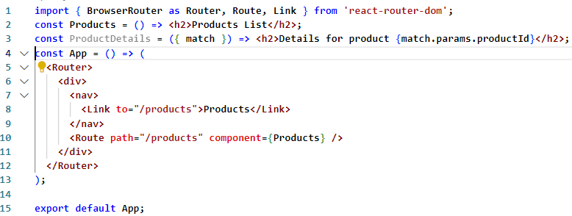
Nested routes
Setting Up Nested Routes: use the <Route> component from React Router.
Notes:
import React from "react";
import { BrowserRouter as Router, Routes, Route, NavLink, Outlet, useParams } from "react-router-dom";
const Home = () => <h2>🏠 Home Page</h2>;
// Parent Component: UserProfile Layout with Nested Routes
const UserProfile = () => {
const { username } = useParams(); // Get username from URL
return (
<div>
<h2>👤 Profile of {username}</h2>
<nav>
<NavLink to={`/user/${username}/posts`} className={({ isActive }) => (isActive ? "active-link" : "")}>
Posts
</NavLink>{" | "}
<NavLink to={`/user/${username}/settings`} className={({ isActive }) => (isActive ? "active-link" : "")}>
Settings
</NavLink>
</nav>
<Outlet /> {/* Nested Route will be rendered here */}
</div>
);
};
// Nested Route Components
const UserPosts = () => {
const { username } = useParams();
return <h3>📝 {username}'s Posts</h3>;
};
const UserSettings = () => {
const { username } = useParams();
return <h3>⚙️ {username}'s Settings</h3>;
};
// Navigation Menu
const Navbar = () => {
return (
<nav>
<NavLink to="/" className={({ isActive }) => (isActive ? "active-link" : "")}>
Home
</NavLink>
{" | "}
<NavLink to="/user/johndoe" className={({ isActive }) => (isActive ? "active-link" : "")}>
John Doe
</NavLink>
{" | "}
<NavLink to="/user/alice" className={({ isActive }) => (isActive ? "active-link" : "")}>
Alice
</NavLink>
</nav>
);
};
const App = () => {
return (
<Router>
<Navbar />
<Routes>
<Route path="/" element={<Home />} />
<Route path="/user/:username" element={<UserProfile />}>
<Route path="posts" element={<UserPosts />} />
<Route path="settings" element={<UserSettings />} />
</Route>
</Routes>
</Router>
);
};
export default App;

Slide 33
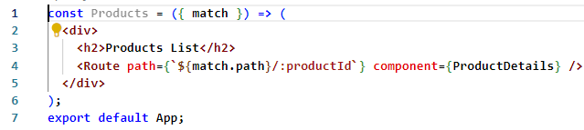
Nested routes
Setting Up Nested Routes
add the nested route for product details:

Slide 34
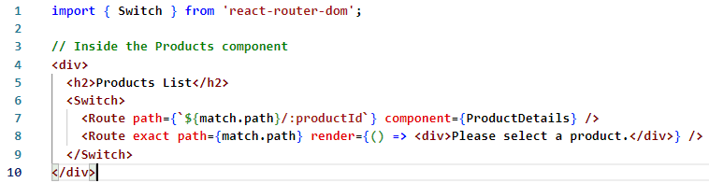
Nested routes
Using Switch for Nested Routes: To ensure that only one route is rendered at a time within the nested structure, you can use the <Switch> component:
Notes:
Switch trong React Router v5:
Switch đảm bảo rằng chỉ một Route được render tại một thời điểm.
Route đầu tiên khớp sẽ được hiển thị.
Nested Routes với match:
match.url dùng để tạo đường dẫn động (/user/johndoe/posts).
match.path dùng để định nghĩa Route.
useParams() để lấy tham số từ URL:
useParams() giúp lấy giá trị username từ URL.
Nếu bạn đang dùng React Router v6:
Không cần Switch, thay vào đó dùng Routes.
Thay component={Component} bằng element={<Component />}.
Dùng <Outlet /> thay vì match.

Slide 35
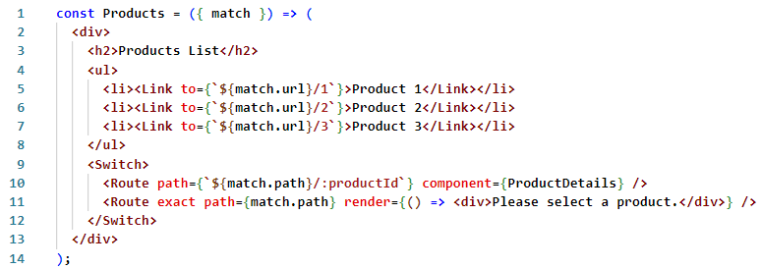
Nested routes
Linking to Nested Routes: To link to nested routes, you can use the <Link> component:
Notes:
Here, match.url gives us the matched portion of the URL, which we use to create links to each product detail page.

Slide 36

Nested routes
Passing Props to Nested Routes: Sometimes you need to pass additional props to components rendered by a route. You can do this using the render prop instead of component
Notes:
https://app.studyraid.com/en/read/1665/22497/redirects-and-route-guards

Slide 37
Programmatic navigation
Programmatic navigation is a powerful feature in React Router that allows you to navigate through your application without the need for anchor tags or buttons.
This can be particularly useful in situations where you need to redirect a user after an event, such as a form submission or an authentication process.

Slide 38
Programmatic navigation
The history Object: React Router provides a history object which is responsible for managing session history for a web page.
This object contains methods to navigate forward and backward through the history stack, as well as pushing and replacing entries

Slide 39
Programmatic navigation
The methods available on the history object:
history.push(path, [state]): Navigates to a new page by pushing a new entry onto the history stack.
history.replace(path, [state]): Navigates to a new page by replacing the current entry on the history stack.
history.goBack(): Moves back one step in the history stack.
history.goForward(): Moves forward one step in the history stack.
history.go(n): Moves n steps in the history stack (positive for forward, negative for backward).
Notes:
import React from "react";
import { BrowserRouter as Router, Routes, Route, useNavigate } from "react-router-dom";
const Home = () => <h2>🏠 Trang Chủ</h2>;
const Login = () => {
const navigate = useNavigate(); // Hook để điều hướng
const handleLogin = () => {
// Xử lý đăng nhập (giả lập)
alert("Đăng nhập thành công!");
navigate("/dashboard"); // Chuyển hướng đến trang Dashboard
};
return (
<div>
<h2>🔑 Đăng Nhập</h2>
<button onClick={handleLogin}>Đăng nhập</button>
</div>
);
};
const Dashboard = () => <h2>📊 Dashboard</h2>;
const App = () => {
return (
<Router>
<Routes>
<Route path="/" element={<Home />} />
<Route path="/login" element={<Login />} />
<Route path="/dashboard" element={<Dashboard />} />
</Routes>
</Router>
);
};
export default App;

Slide 40
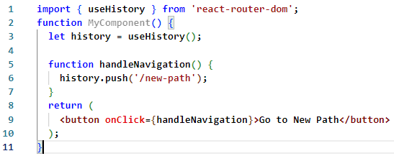
Programmatic navigation
Accessing history in Components: There are several ways to do this:
Using useHistory Hook: For functional components, the useHistory hook from react-router-dom provides access to the history object.
Examp:

Slide 41
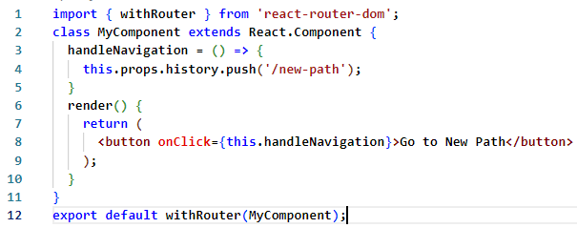
Programmatic navigation
Using withRouter Higher-Order Component: For class components, you can use the withRouter higher-order component to inject the history object as a prop.
Example:

Slide 42
Programmatic navigation
Using useParams, useLocation, and useRouteMatch
Other hooks like useParams, useLocation, and useRouteMatch can also provide access to the history object indirectly by providing the necessary context to perform navigation.

Slide 43
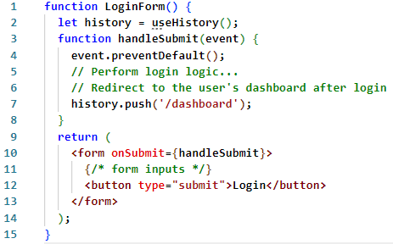
Programmatic navigation
Redirecting After Actions: One common use case for programmatic navigation is redirecting the user after an action, such as a successful form submission.
Example:

Slide 44
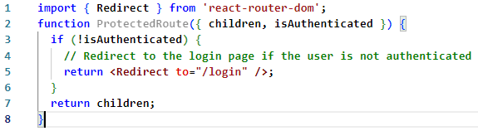
Programmatic navigation
Protecting Routes with Redirects: Sometimes, you may want to protect certain routes and redirect users if they are not authorized to view them. Programmatic navigation can be used to achieve this.
Example:

Slide 45
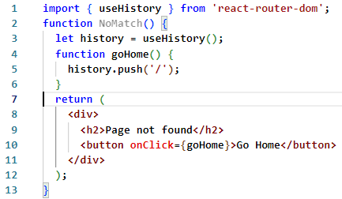
Programmatic navigation
Handling Not Found Pages: When a user navigates to a route that doesn't exist, you can use programmatic navigation to redirect them to a "Not Found" page or back to the home page
Example:

